Slide 1



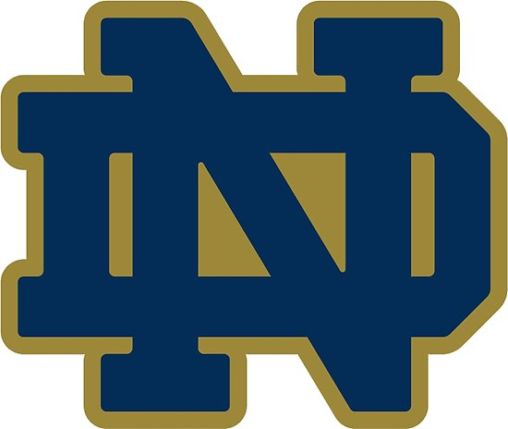
From the university to the twitteverse
An analysis of tweets about major universities
Prepared by Matthew Dunne

Slide 2
Executive summary and methodology
Executive summary
methodology
Prolific tweeters are not same as influential tweeters
About 10% of UC tweeters are in Chicago, which is average
Some spikes for big stories
Most tweets are not unique but UC tweets are different from other universities
Filter twitter data (approx. 60 M tweets about “Chicago” or “university”) by school (UC, IU, Notre Dame, Marquette), tweet feature*
Run same analysis for all universities (prolific/influential users, location, timeline of tweets, what tweets are about)
Similarity of tweets by SimHashing. Test various thresholds and see how they perform
*['text', 'user.name', 'user.screen_name', 'user.followers_count', 'retweeted_status.retweet_count', 'entities.hashtags.text', 'user.location', 'user.time_zone', 'place.country', 'place.full_name', 'place.name’, 'created_at', 'timestamp_ms', 'lang']

Slide 3
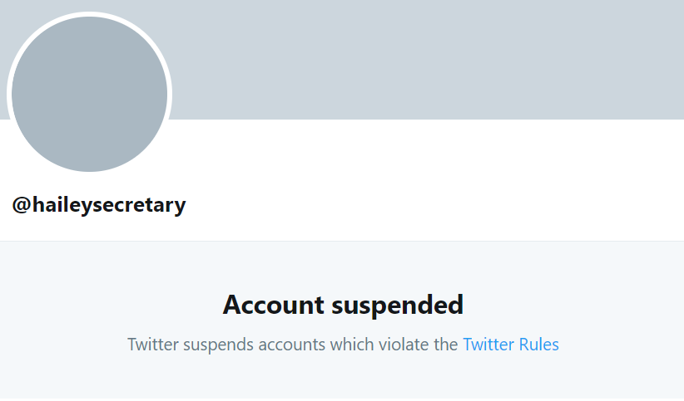
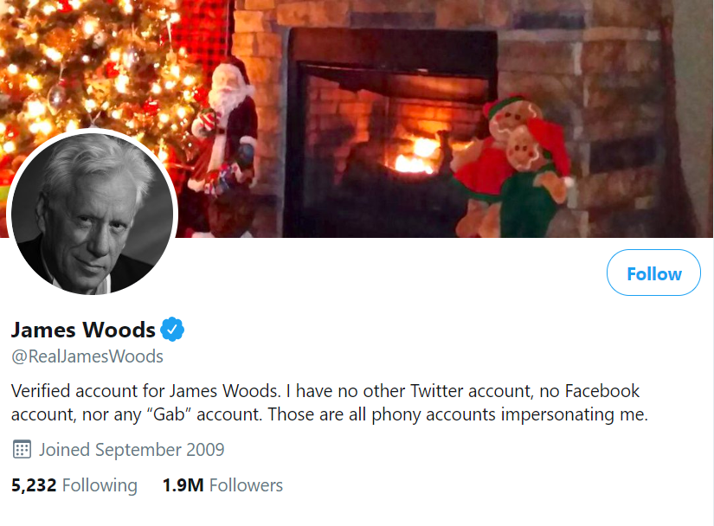
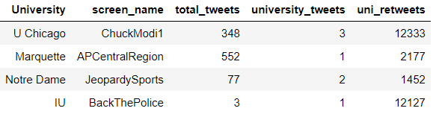
The biggest users
The people that tweet the most about a given university are not the most re-tweeted
If something gets re-tweeted a lot it is probably from a well known account or an important topic that happens to mention the university, e.g. famous actor James Woods, police training
True for all universities I examined
User with Most Tweets about U Chicago
User with Second Most Re-tweets about
U Chicago
The most influential tweeters are not tweeting about the university that much

Slide 4
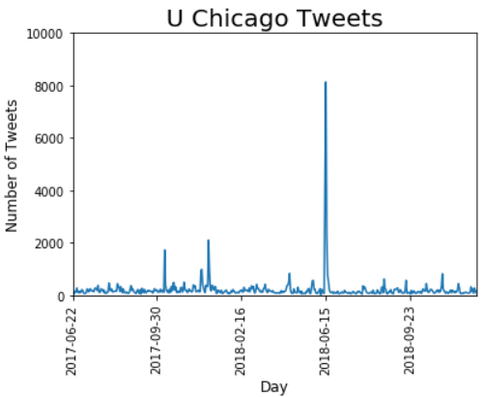
User locations - Are users located in the area we associate with that university? Timeline of tweets – gaps and spikes
Location: about 10%-12% of users are local, except for Notre Dame, which is almost certainly because few stay in South Bend
Timeline: generally a very low level on any given day during the period. Never a day without at least one tweet/retweet
'RT @ChuckModi1: University of Chicago dropping SAT is huge win against classism. Then THIS:UofC is announcing guarantee of free tuition'

Slide 5
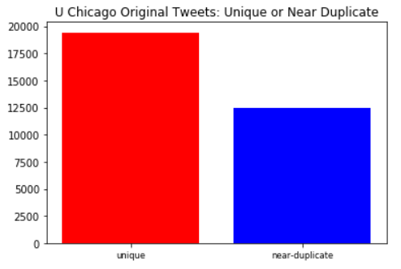
Uniqueness of tweets
Are the tweets about any given university unique or are they mostly about the same topic?
Significant percentage are re-tweets (68% in the case of U Chicago) → not unique
Of those that are not re-tweets significant percentage are substantially the same, e.g. same tweet with a different URL link
Note: used SimHash threshold of 9

Slide 6
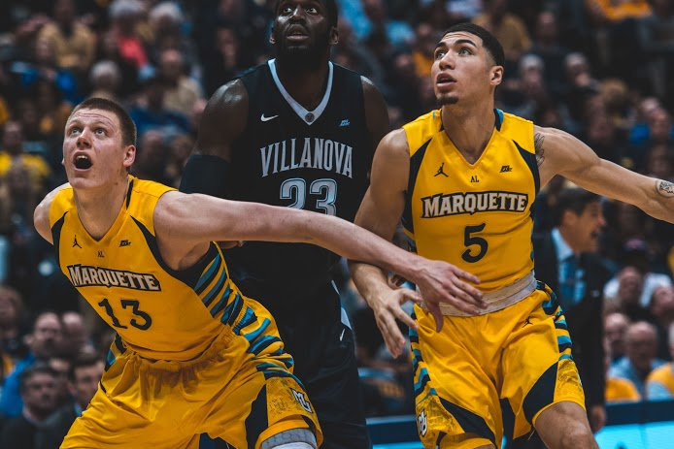
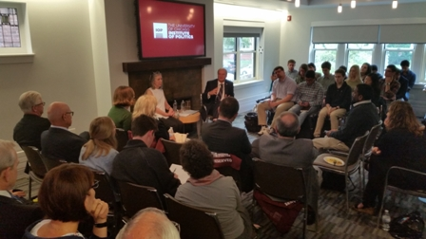

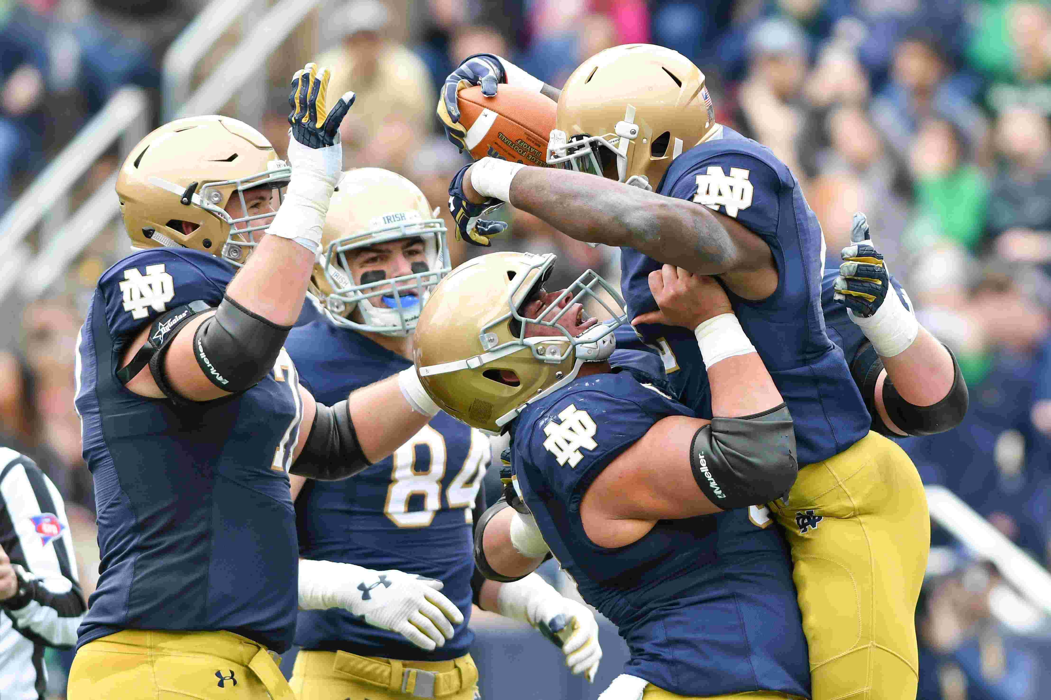
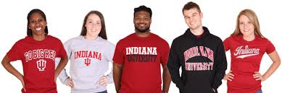
U Chicago users vs. others what do they tweet about?
Look at the top ten tweeters (incl. retweet), get random sample of their tweets
We see a pattern in what these tweets are about!
IU: promotions (Lyft and apparel)
Marquette: basketball
Notre Dame: football
U Chicago: academic events

Slide 7
Insights and recommendations
To increase outreach/buzz, get the university associated with an important topic or an influential twitter user. Prolific does not mean influential.
About 10% of U Chicago tweeters are in the area, which appears about average.
Do not copy other universities – the brand is academics not sports.
Know what your metric is. Majority of tweets are retweets, near duplicates. Volume is not engagement!!!

